Slide 1
Facial Acne Detection System
Team Memphis
Chenhao Li, Hao Liu, Haoze Liu, Mingyang Yu

Slide 2
Content
Part 1
Problem clarification
Part 2
Challenge and Solutions
Method explanation
Part 3
Current code and Result
Part 4
Future Improvements and Conclusion
Speaker: Hanze

Slide 3
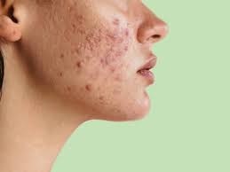
Background
Acne is a common dermatological condition affecting individual of all ages
Manual acne detection can be subjective, Time-consuming, and prone to errors
The goal is to develop an automated, Computer-vision-based system to identify and assess facial acne conditions
Speaker:Hanze
Notes:
Acne is one of the most common skin conditions out there—it doesn’t discriminate by age, showing up for teenagers, adults, and everyone in between. It can be a source of frustration, and dealing with it is no easy task.Traditionally, this relies on manual observation by dermatologists, which can be subjective, time-consuming, and prone to errors.
Our solution? An automated, computer-vision-based system for identifying and assessing acne. This technology makes detection faster, more accurate, and completely objective, providing consistent results to guide treatments and skincare routines.

Slide 4
Objective
Accurately detect acne spots on facial images
Classify acne types (nodule, papule, pustule)
Provide a quantitative assessment for dermatological insights.
Speaker:Hanze
Notes:
Our goal with this system is simple and clear. First, we aim to accurately detect acne spots on facial images, ensuring precise and reliable results. Next, we want to classify different types of acne to provide detailed insights. Lastly, we strive to offer a quantitative assessment, analyzing factors like acne size and distribution to support both professional dermatologists and personal skincare routines.

Slide 5
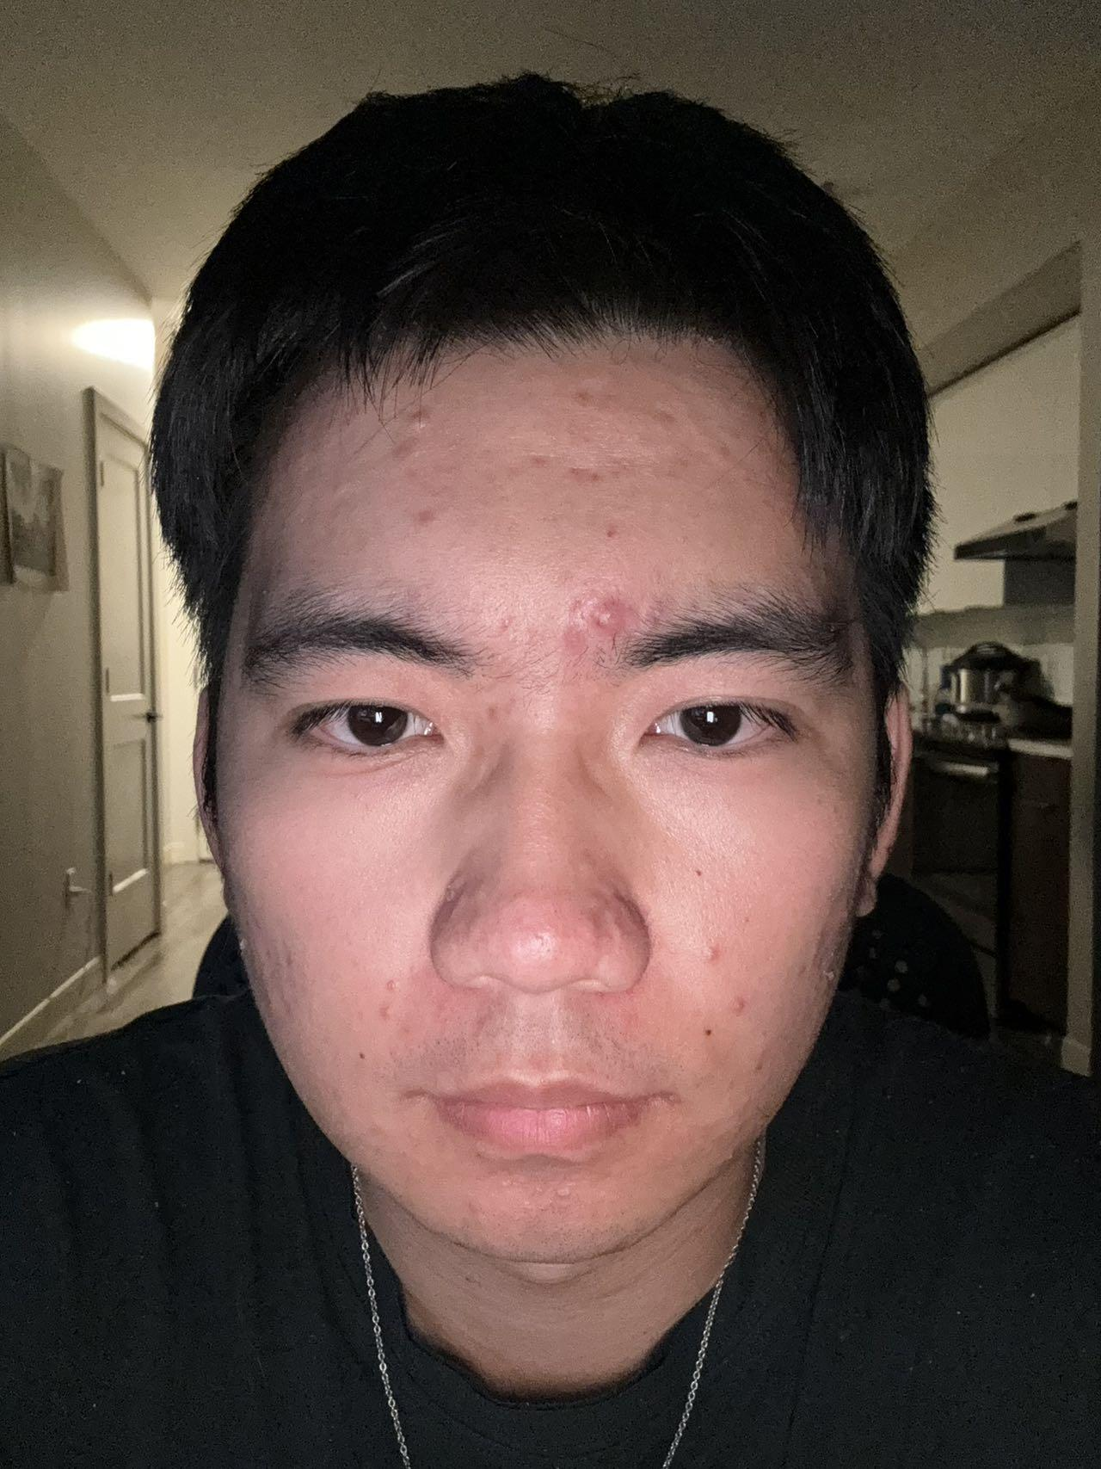
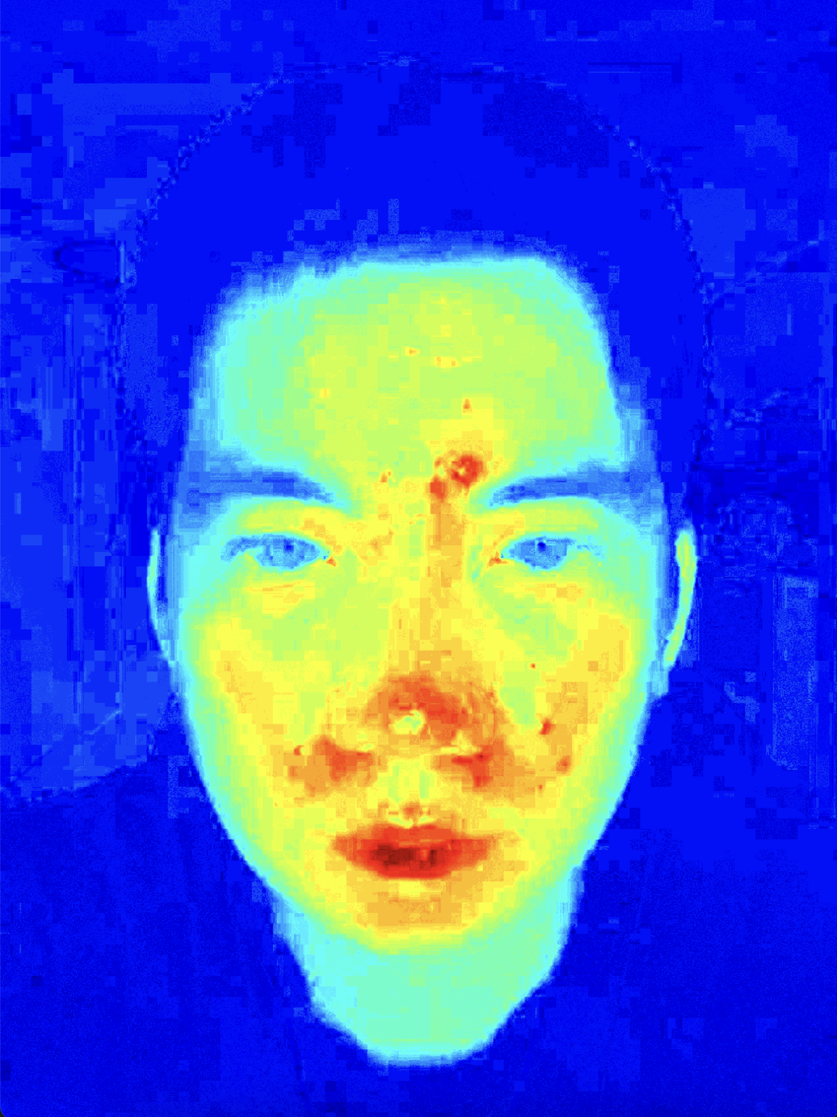
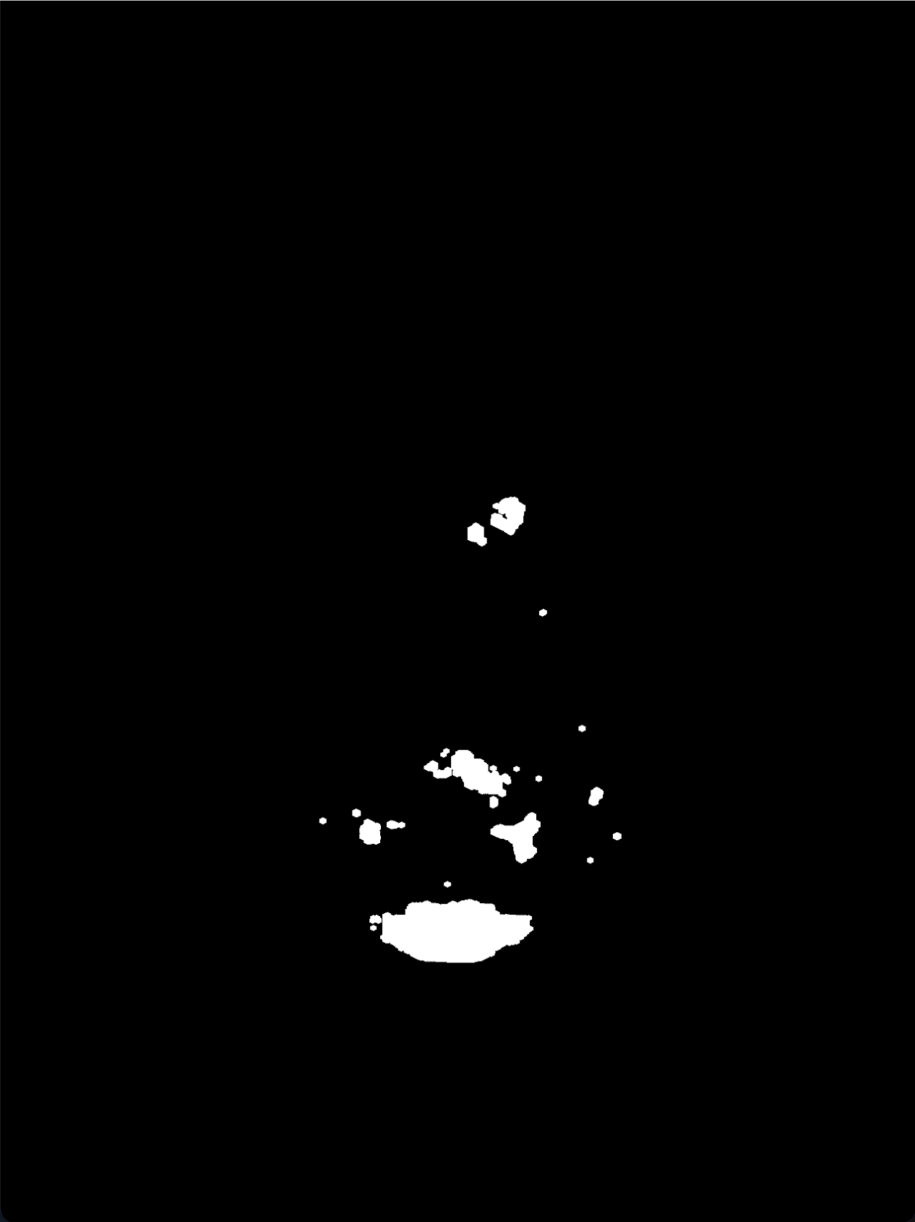
Method Explanation - Finding Acne
Fundamental Way to Identify Acne Areas
A-channel from the LAB color space
Efficient Identification
Top 0.1% Redness
Filtering:
Gaussian Blurring
Dilation
Original Image
A-Channel
Color Map
Top 0.1%
Redness
Speaker: Chenhao
Notes:
The analysis is based on the A-channel of the LAB color space.
Why LAB?
LAB color space separates lightness (L) making it ideal for isolating redness.
The A-channel specifically captures the green-to-red spectrum.
—-----------------------
The top 0.1% redness threshold is used to focus on the potential red regions in the A-channel.
This ensures areas likely to be acne, are considered, while ignoring noise
—--------------------
Gaussian Blurring:
Smooths the A-channel to reduce noise.
Dilation:
Expands the detected red regions to ensure complete coverage of acne spots.

Slide 6
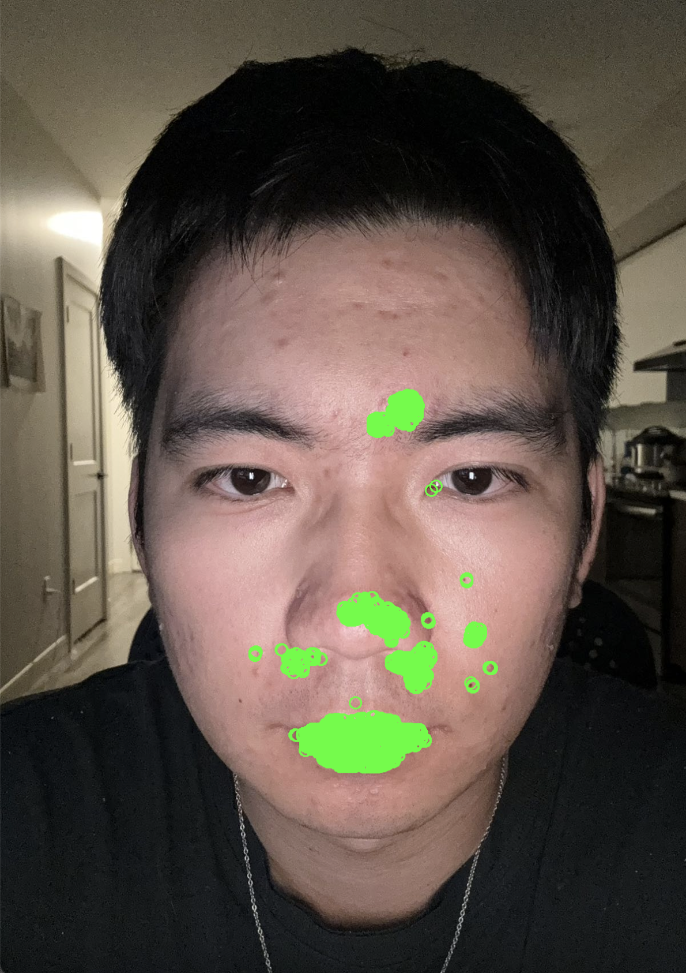
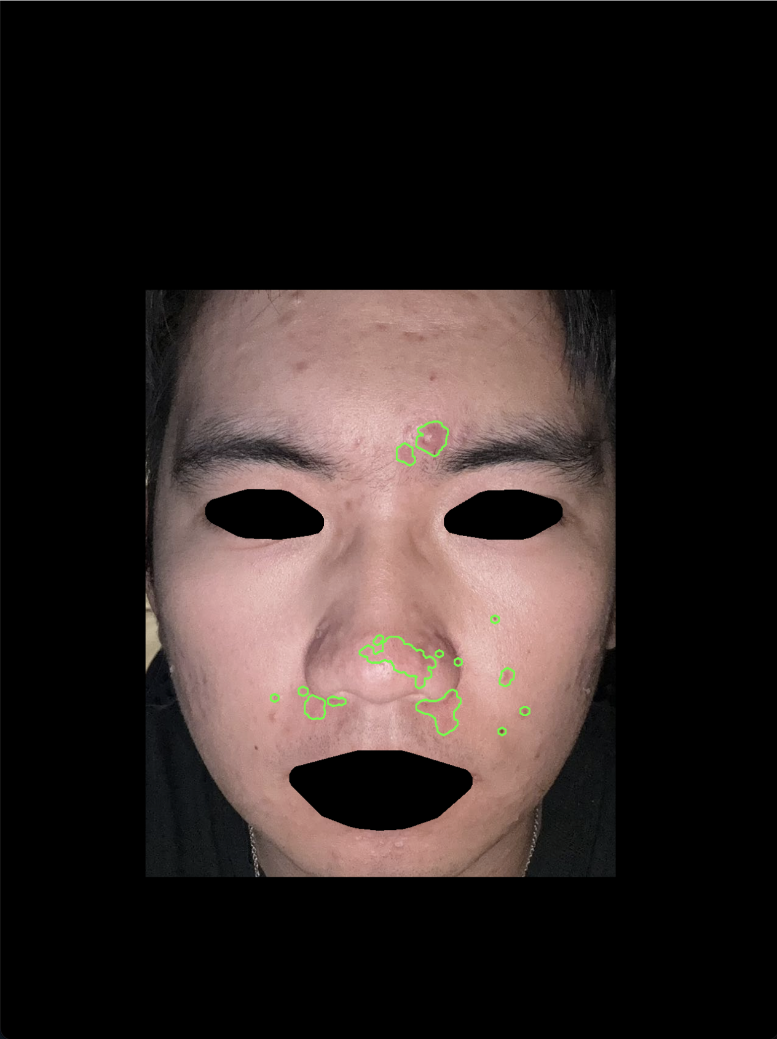
Challenge and Solutions
False detection :
Masking Using dlib face detector
Original Image
Redness on Eyes and Mouth
Mask Background Eyes and Mouth
Speaker: Chenhao
Notes:
False Detection:
Challenge:
The face detection algorithm might include irrelevant areas or miss features, leading to inaccurate analysis.
Solution:
Used dlib's facial landmark detector to create precise masks that isolate the face while excluding the eyes, mouth, and background.

Slide 7
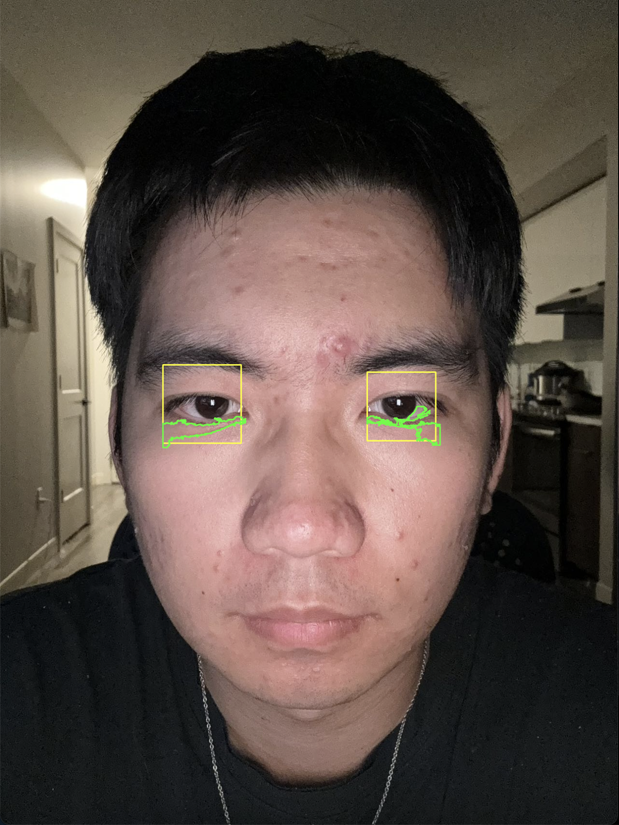
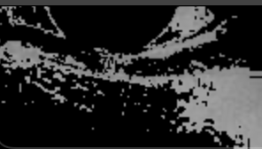
Method Explanation - Eye Bag & Dark Circle
Eye detection
Implement cv2.CascadeClassifier()
Create bounding rectangle
Eye bag and dark circle detection
Extract the lower half the eye rectangle
Use cv2.bitwise_or to filter the image with
lower and upper threshold bound
Draw the contour
Sort the contours and draw the largest one
Binary image of lower part of the eye
Detected dark circle
Speaker: Mingyang Yu
Notes:
In addition to acne detection, our program can also detect eye bad and dark circle under the eyes. To do it, we first use eye detection, which is achieved by cascade classifier function that creates bounding rectangle around eyes. Then, we extract the lower half of eye rectangle and the bitwise or function to filter it. Lastly, draw the contours for the largest white region which represent the eye bad and dark circle

Slide 8
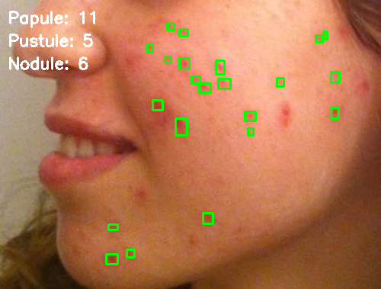
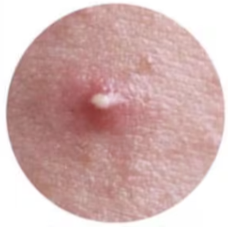
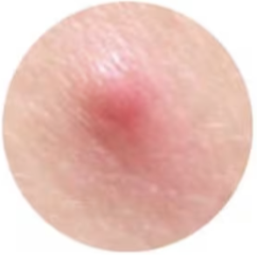
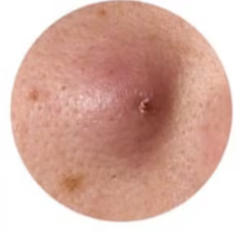
Other Features - Acne Classification
Ground truth acne images
Three types of acnes
pustule
papule
nodule
Speaker: Mingyang Yu
Notes:
Our program also has some small features such as acne classification. Different types of acnes reflect different body conditions. For example, eating hot pot, feeling stressed, staying up late can all cause different ances, that why we want to classify them. Here we have three ground truth images which represents pustule, papule and nodule. By comparing each acne contour to the ground truth images, our program successfully classifies the acnes.

Slide 9
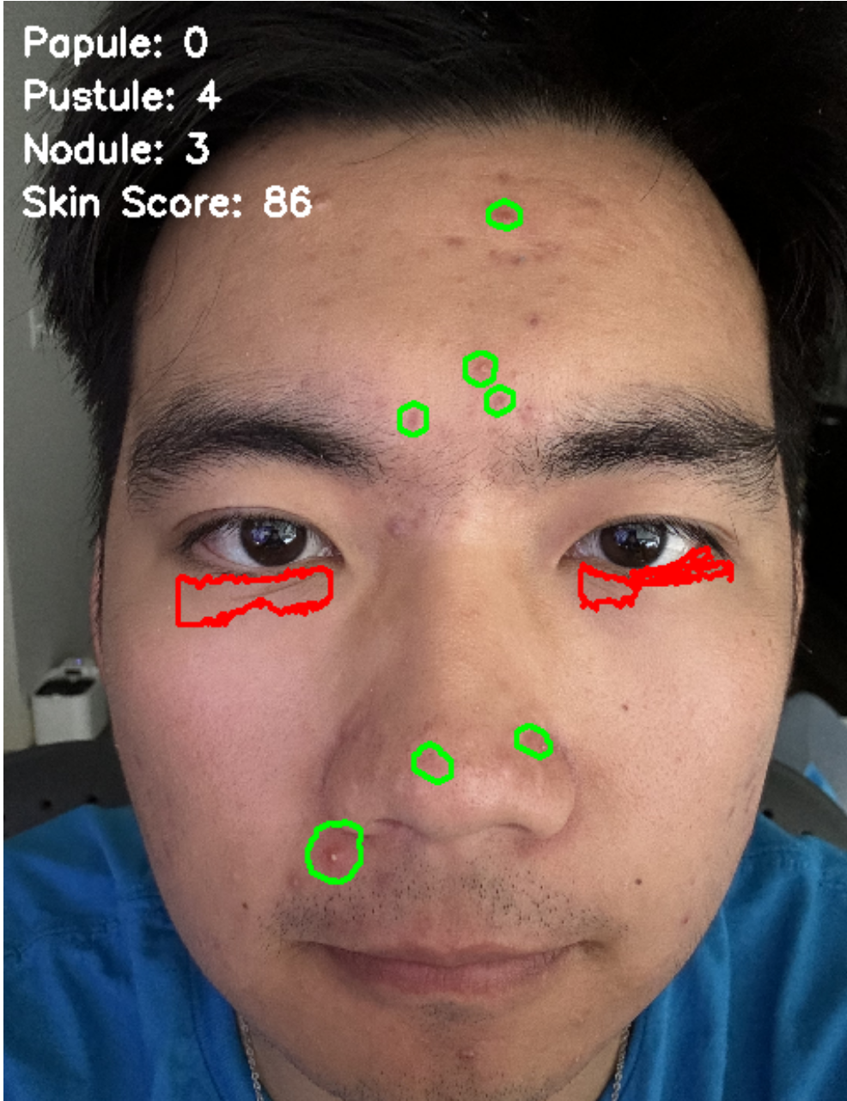
Other Features - Facial Condition Score
Two key metrics evaluate for the score
Number of Detected Contours
Average Redness Intensity
Scoring Formula
score = max(0, 100 - num_contours * 2 - int(average_redness / 500))
Score Range:0 - 100
Speaker:

Slide 10
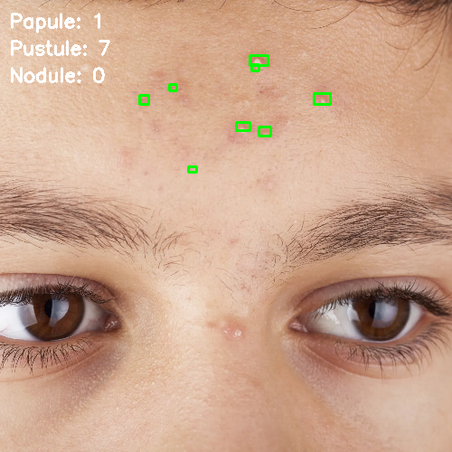
Enhancing Acne Detection with Local Face detection
Facial Region Selection
Allow users to select specific areas (e.g., forehead, cheeks, chin).
Use a bounding rectangle to isolate the chosen region for analysis.
Localized Acne Detection
Apply acne detection algorithms only within the selected region.
Use color filtering and HSV to identify acne spots.
Improved Accuracy
Focus on smaller areas reduces interference from unrelated features.
Analyze regional patterns for better precision in detection.
Speaker: Hao Liu
Notes:
For the local face detection, our program allow user use the mouse to select the region of interest, for the choosed ROI, we separate the green channel because the green channel is commonly used in image medical processing to deal with skin damage and the green channel will not effect by light and dark condition. Then, use the HSV to do the second threshold for acne detection.

Slide 11
Code Overview for Full Face Detection
Input
image
Draw Contours
Convert to LAB Space and Extract A Channel
Detect Red Regions
Classify Acne
Mask Mouth and Eye
Calculate Score
Detect bags under eyes
Output Results
Speaker: Hao Liu
Notes:
Here is the flow chart for the Full face detection, we will separate two parts, the first one is using LAB color space to detect the acne and second one is eye bags detection and combine two result together and get the output results

Slide 12
Code Overview for Local Face Detection
Input
image
H < 10
S > 70
V > 50
Green Channel Separation
User Select the Region Of Interest
Find Contour
Not Acne
Output Results
Classify Acne
Effective Contour
Speaker: Hao Liu
Notes:
Here is the flow chart for the Local Face Detection, firstly, we will use the green channel to do the first acne detection and then we will use the HSV to make a decision to filter out the mostly possible acne and give the user the final output image.

Slide 13

Code Example
Speaker:

Slide 14
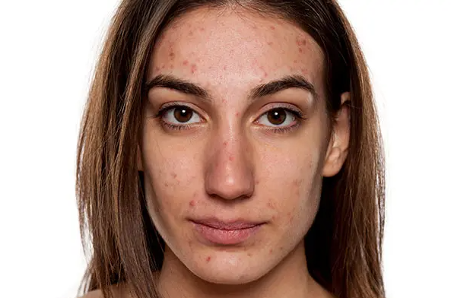
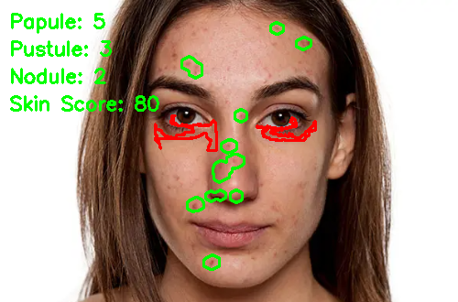
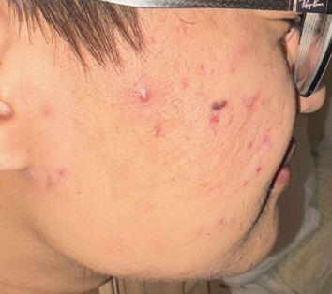
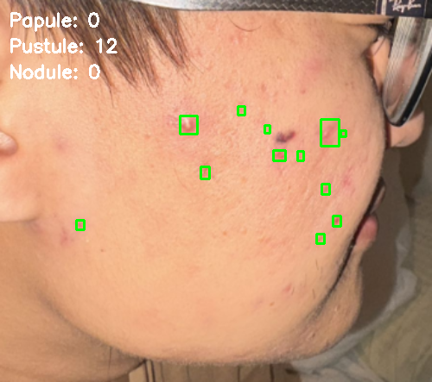

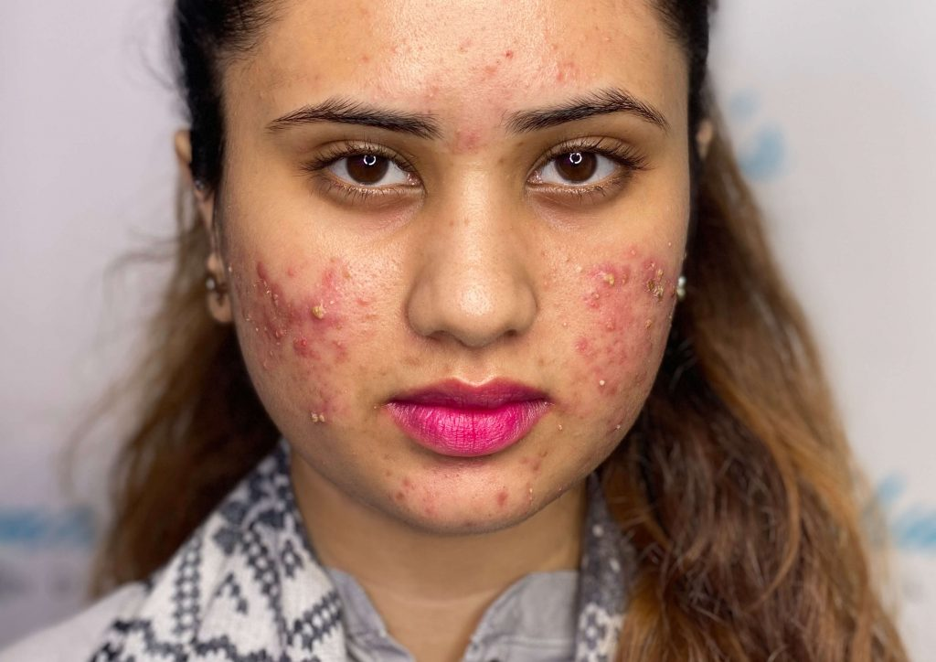
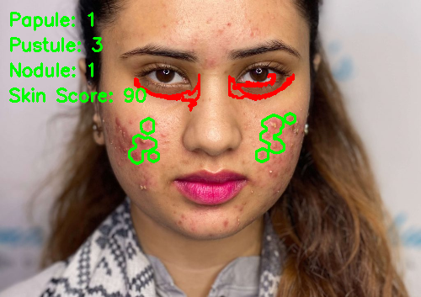
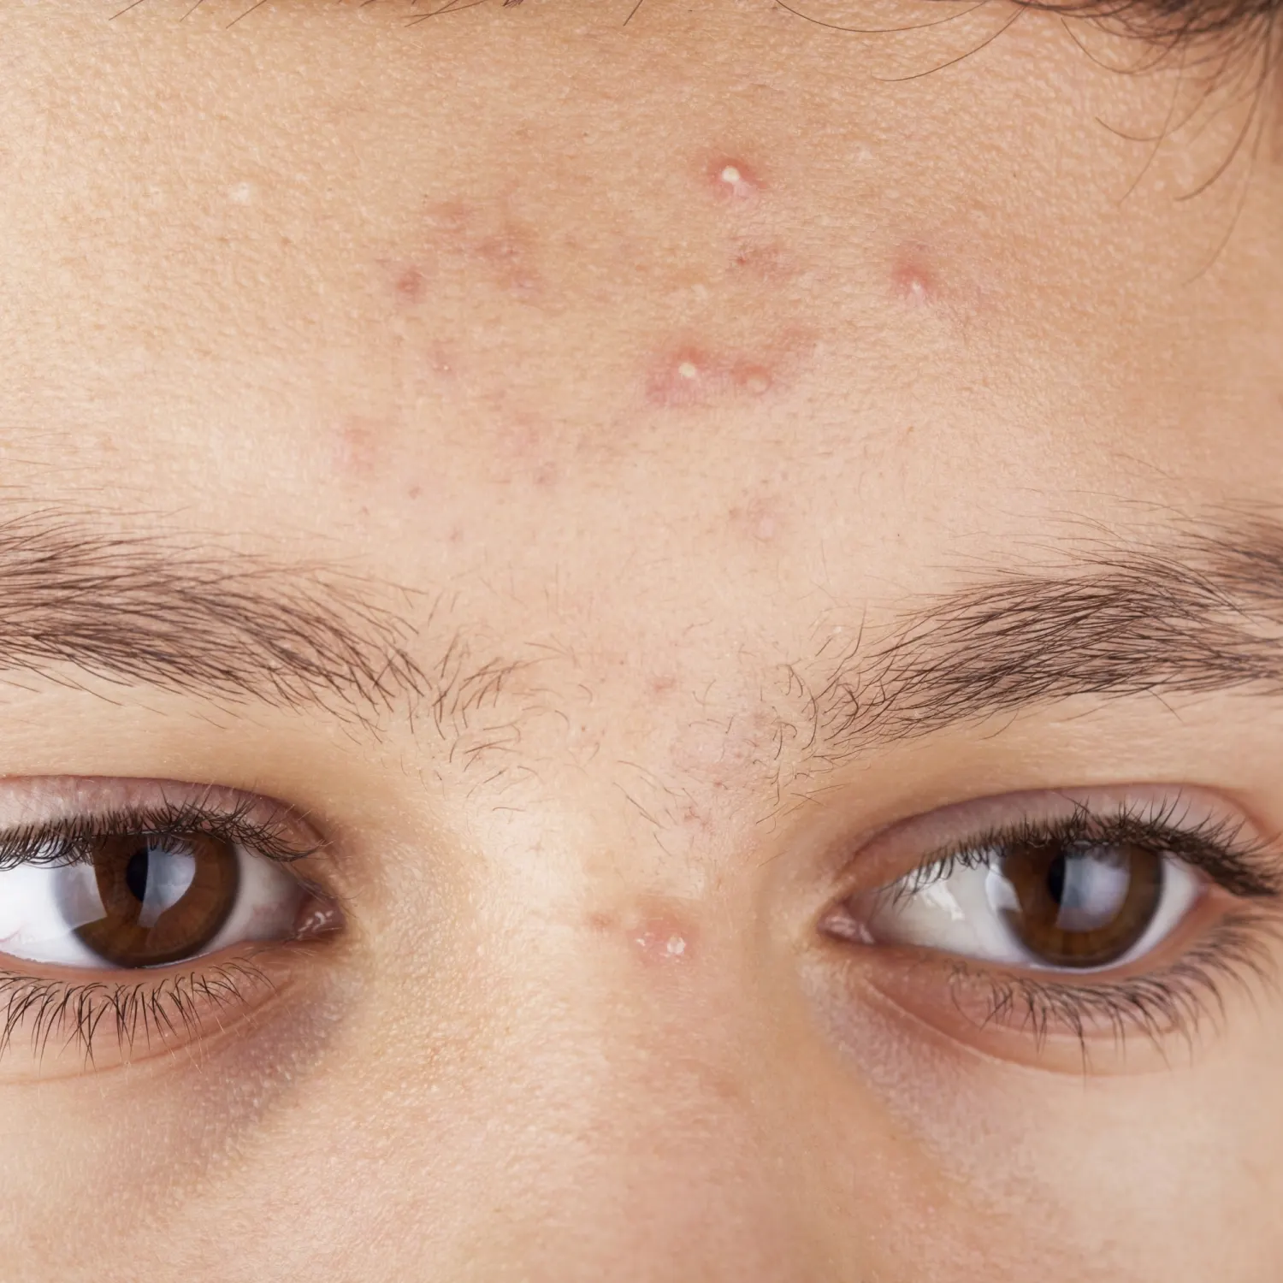


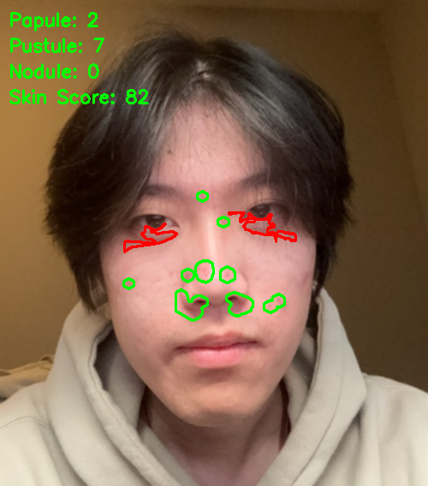
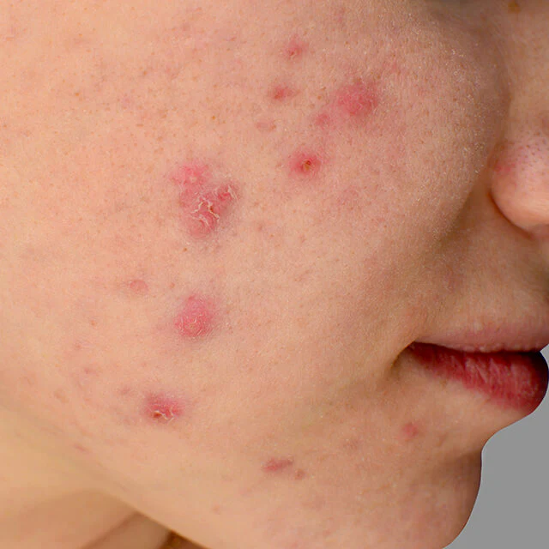
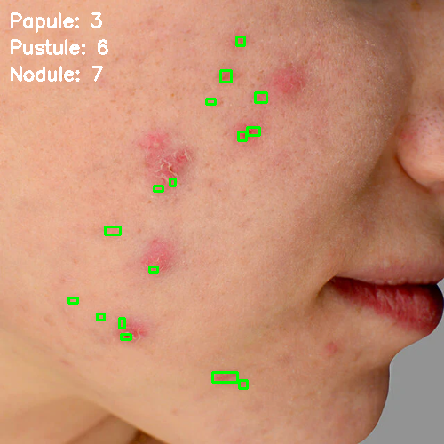
Result
Full Face Detection Local Face Detection
Speaker:

Slide 15
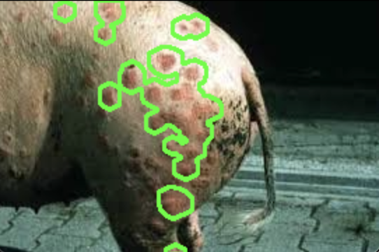
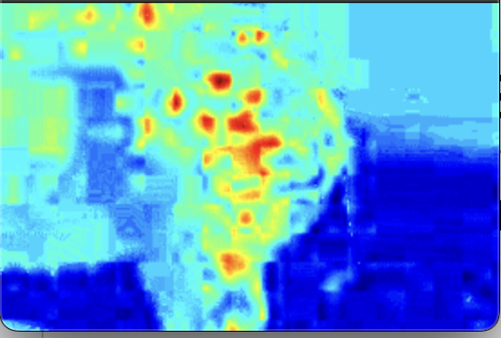
Other Possible Implementation
Disease detection for livestock
Swine Erysipelas
Speaker: Mingyang Yu
Notes:
Now, after seeing these results, our program does do a pretty good job. We start to think what else, or what other field can our program be implemented. The first example is the livestock industry. Here’s a image of a pig that has Swine Erysipelas which is an infectious disease. With the help of our program, these disease can be detected earlier.

Slide 16
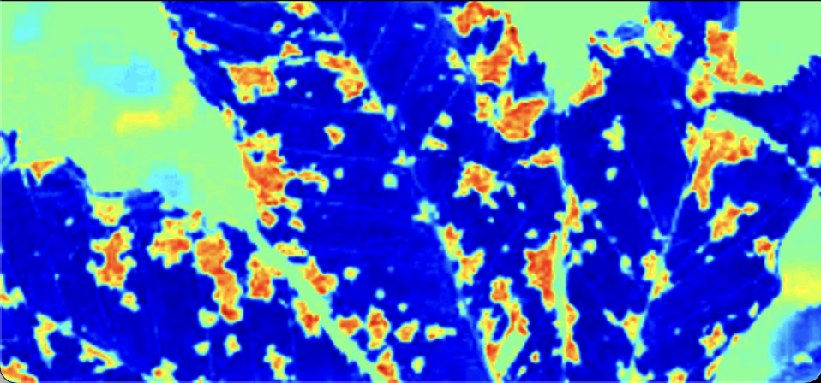
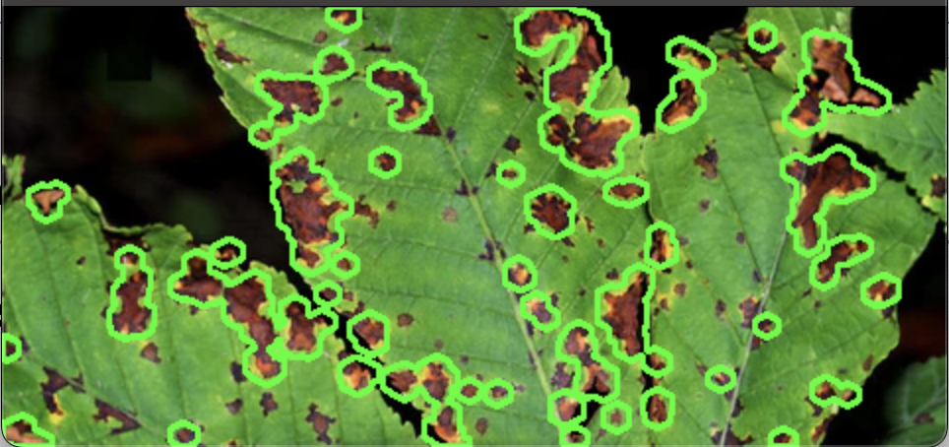
Other Possible Implementation
Disease detection for plant
Rust and Bacterial Canker & Red Blotch
Speaker: Mingyang Yu
Notes:
Another implementation is for the agriculture. These disease is called rust, canker or sometime is red blotch. Canker is a bacterial disease which infect the stem and leave of peaches, cherries. So detect earlier, control earlier

Slide 17
Future Improvement
Enhanced Accuracy:
Train an AI model to improve precision in identifying various types of acne, such as white heads, blackheads, and pustules.
Expanded detection capabilities:
Add functionality to detect addition skin conditions, including acne scars, dark spots, and post-inflammatory masks.
Location-Based Analysis:
Detect the specific location of acne on the face to provide personalized skin care recommendations tailored to the affected areas
Actionable Insights:
Offer advice on targeted treatments or preventive measures based on the acne’s type,severity, and distribution
Speaker:Hanze
Notes:
Speech Script: Future Improvements
Looking ahead, we see many exciting opportunities to improve our system.
First, we plan to enhance accuracy by training a more advanced AI model. This will help us better identify different types of acne, such as whiteheads, blackheads, and pustules.
Next, we aim to expand the system’s capabilities to detect more skin conditions, including acne scars, dark spots, etc
We’re also exploring location-based analysis to pinpoint the exact positions of acne on the face. This will allow us to offer personalized skincare recommendations tailored to specific areas.
Lastly, we want to provide actionable insights by suggesting targeted treatments and preventive measures based on acne type, severity, and distribution.
These improvements will make the system more precise, comprehensive, and helpful for both dermatologists and individual users. Thank you!

Slide 18
Questions?

